Slide 1
Chapter 5
Ordered List

Slide 2
Overview
Linear collection of entries
  All the entries are arranged in ascending or descending order of keys.

Slide 3
Learning Objectives
Describe the properties of an order list.
Study binary search.
Understand how a Java interface may be designed in order to ensure that an ordered list consists only of objects that may be sorted.
Design the public interface of an ordered list class in Java.
Learn how to merge two ordered list in an efficient manner

Slide 4
Learning Objectives
Develop a list consolidation application based on merging.
Implement an ordered list class in Java using an array list component.

Slide 5
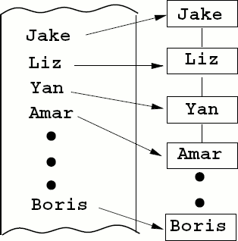
5.1 Introduction
Big graduation party.
  Draw up an initial list of invitees.
  Lots of people being added or deleted or information being changed.
  If you don't care about the order, build an unordered list.

Slide 6
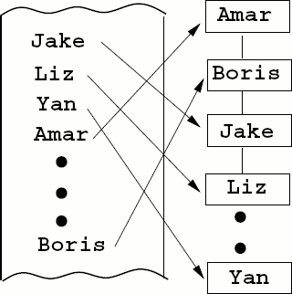
5.1 Introduction
If you were to maintain the names of your invitees in alphabetical order, your program would use an ordered list.

Slide 7
5.1 Introduction

Slide 8
5.1 Introduction
The main advantage in maintaining the names in alphabetical order is that we can search for any particular name much faster than if the names were maintained in an arbitrary order.
  Binary search of n entries takes only O(log n) time in the worst case.

Slide 9
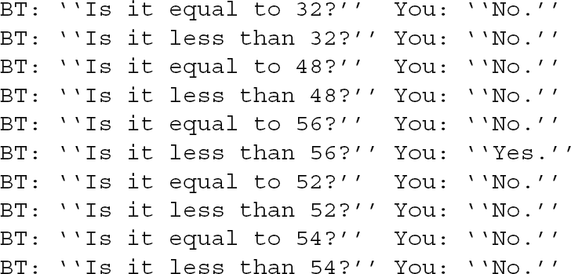
5.2 Binary Search
Think of a number between 1 and 63.

Slide 10
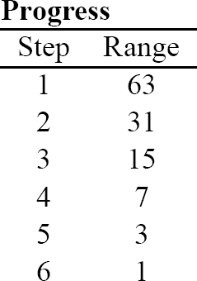
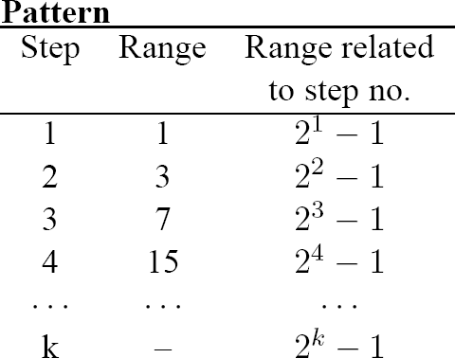
5.2.1 Divide in Half
Cut down the possible range of numbers by half.

Slide 11

5.2.1 Divide in Half
N = 2^{k} - 1

Slide 12
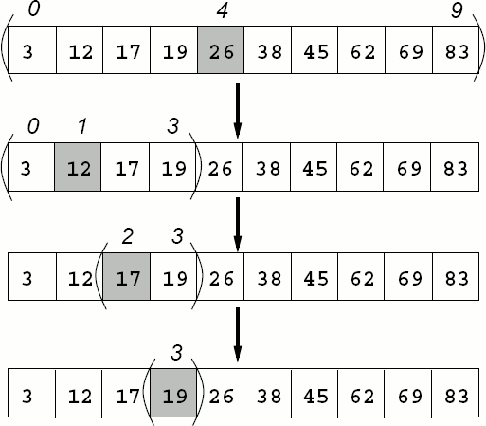
5.2.2 Algorithm
Guessing strategy can be translated into the binary search algorithm applied on an array in which the entries are arranged in ascending order of keys.
  Search for the key 19

Slide 13
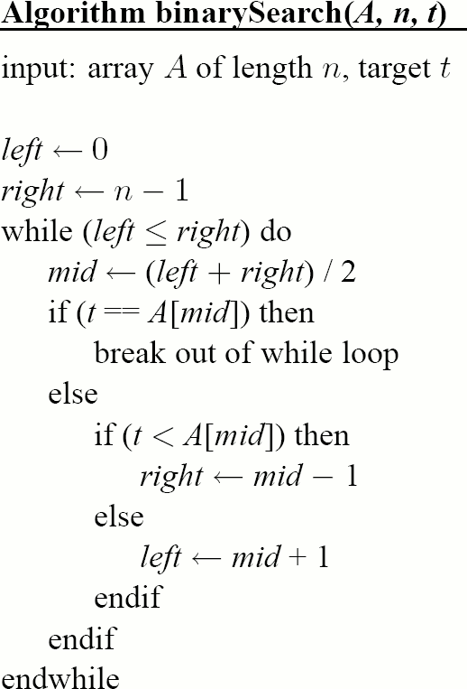
5.2.2 Algorithm

Slide 14
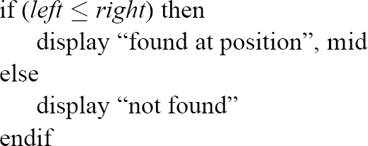
5.2.2 Algorithm

Slide 15
5.2.2 Algorithm
Running time analysis
  The algorithm first makes one comparison to determine whether the target is equal to the middle entry.
  If not, one more comparison is made to go left or right.
  When a search terminates successfully, only one comparison (equality) is made in the last step.

Slide 16
5.2.2 Algorithm
If the search fails to find the target, two comparisons are made in the last step.
  Let there be n entries in the array.
    N = 2^{k} – 1
    It takes 2k -1 comparisons for worst-case success.
    K = log(n + 1)¹
    2log(n + 1) – 1
    2*ceiling(log(n + 1)) – 1 for worst-case success.
    2*ceiling(log(n + 1)) for and worst-case failure.
    Y = ceiling(x) means that y is the smallest integer >= x.
      i.e. ceiling(2,3) =3

Slide 17
5.2.2 Algorithm
O(log n) is possible on an array, but not on a linked list.
In a linked list of accessing the middle entry would take O(n) time.

Slide 18
5.3 Ordering: Interface java.lang.Comparable
When an ordered list searches for or inserts an entry, it would not only need to tell whether two entries are equal, but also whether one entry is less than or greater than another.

Slide 19
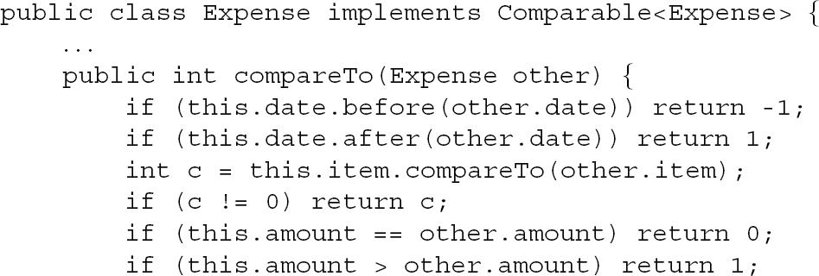
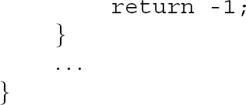
5.3 Ordering: Interface java.lang.Comparable

Slide 20
5.3 Ordering: Interface java.lang.Comparable
The fields need to be given a relative precedence order in the comparison process.
  Date, followed by item, and finally amount.
  Only if the dates are not equal does the Expenses comparison proceed with the comparison of the respective items, possibly working its way through to comparing the respective amounts.
  Since Expenses already implements Comparable<Expense>, DateExpense, ItemExpense and ItemDateExpense would each extend Expense would also implicitly implement Comparable<Expense>.

Slide 21
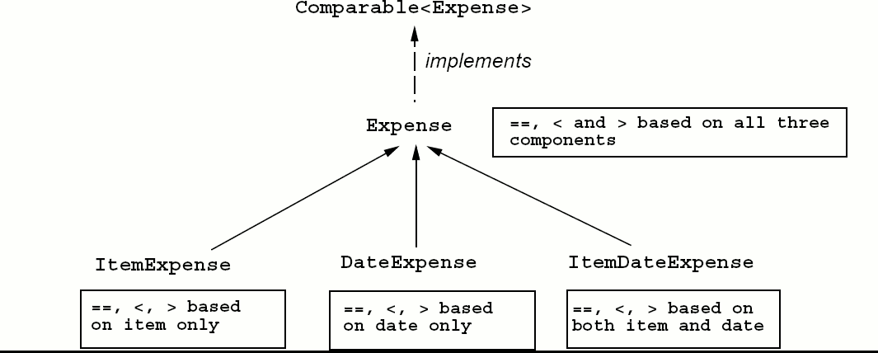
5.3 Ordering: Interface java.lang.Comparable
DateExpense, ItemExpense, and ItemDateExpense would override it to base the comparison on their specific expense.

Slide 22
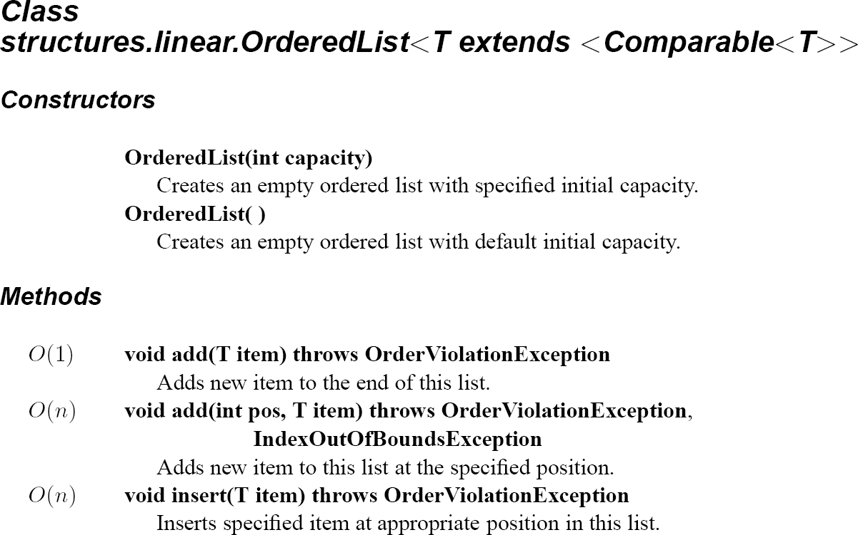
5.4 An OrderedList Class

Slide 23
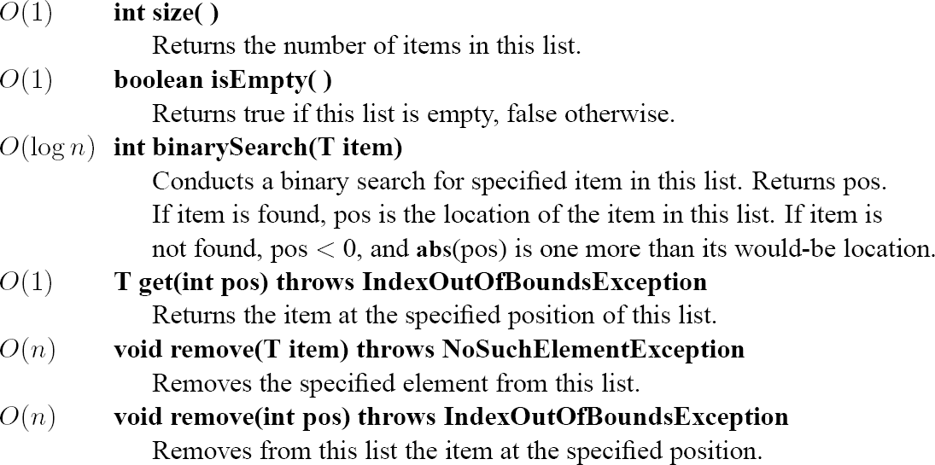
5.4 An OrderedList Class

Slide 24
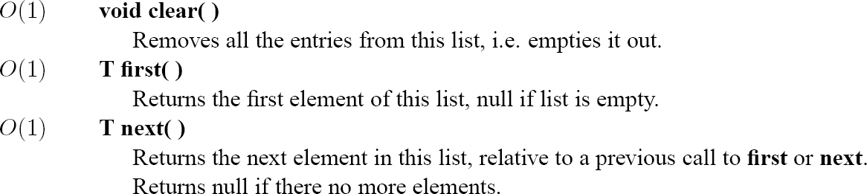
5.4 An OrderedList Class

Slide 25
5.4 An OrderedList Class
Method binarySearch
  If the key is indeed in the list, the method returns the position at which the key is found.
  If the key does not exist in the list, the function returns a negative position whose absolute value is one more than the position at which the key would appear were it to be stored in the list.

Slide 26
5.4 An OrderedList Class
Exceptions
  NoSuchElementException and IndexOutBoundsException are runtime exceptions.
  OrderViolationException is a new exception.
    Insert the key 7 position 2.
    Since 7 is not less than 6, an exception should be thrown.

Slide 27
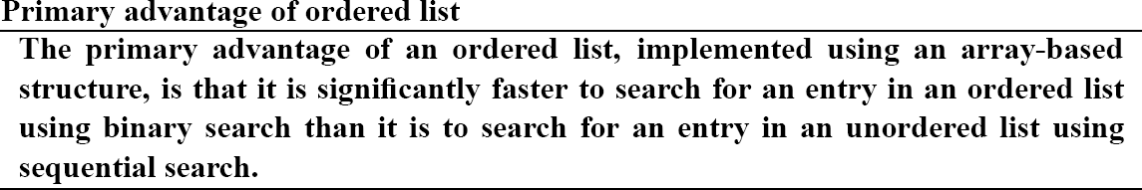
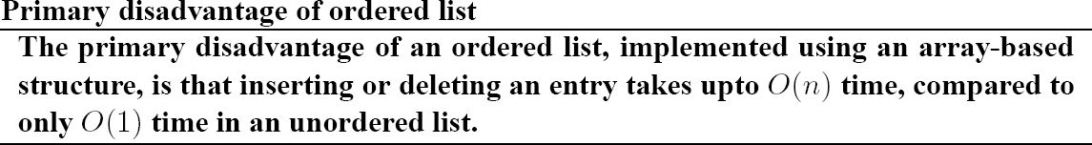
5.4 An OrderedList Class

Slide 28
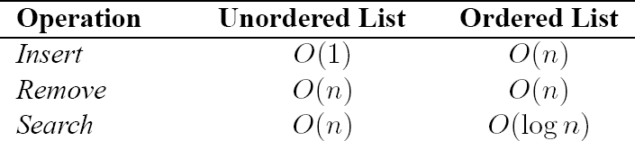
5.4 An OrderedList Class

Slide 29
5.4 An OrderedList Class
If we never store more than a handful of entries, we may want to go with the unordered list to avoid the overhead of data movement while not losing much by way of increased search time.
  If we have a large number of entries and do many more searches than insertions, then the ordered list is a clear winner.

Slide 30
5.5 Merging Ordered Lists
Your room-mate co-hosts your graduation party.
  There are two separate lists of friends that either of you invite.
  Some invitees' names appear in both lists.
  An invitee cancels.
    It can't just be deleted from one of the lists.
    Keep a record of all the deletions that will eventually have to be made.

Slide 31
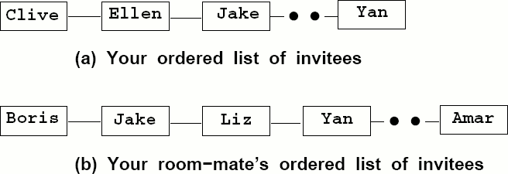
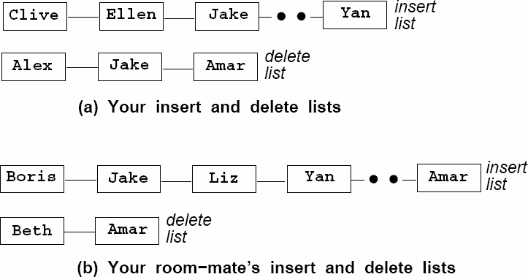
5.5 Merging Ordered Lists

Slide 32
5.5 Merging Ordered Lists
You freeze the list the morning of the party.
  Merge your separate insert list into a single ordered insert list, without duplications.
  Merge your separate delete lists into a single ordered delete list, without duplicates.
  Delete, from the merge insert list, all the names that appear in the merged delete list.

Slide 33
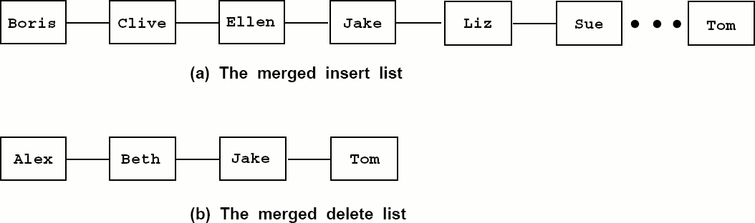
5.5 Merging Ordered Lists

Slide 34
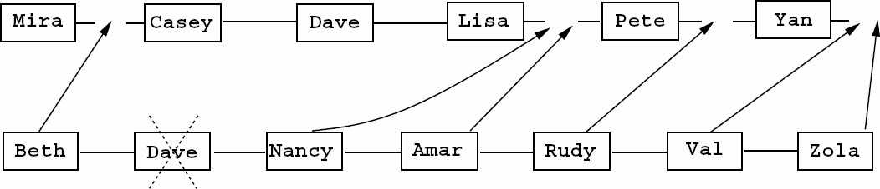
5.5.1 Two-finger Merge Algorithm

Slide 35
5.5.1 Two-finger Merge Algorithm
Inserting into a ordered list can be expensive since it typically involves moving all the entries over to create a spot for the new entry.
  We will build a separate third list to hold the merged entries.
    The first two entries are compared.
    The smaller keyed entry is appended to the result list.

Slide 36
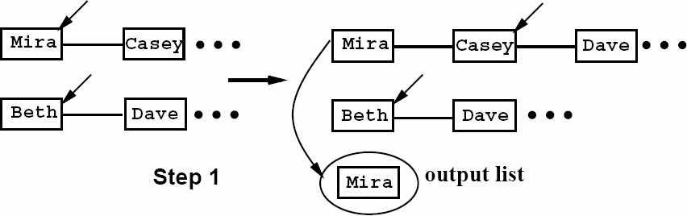
5.5.1 Two-finger Merge Algorithm

Slide 37
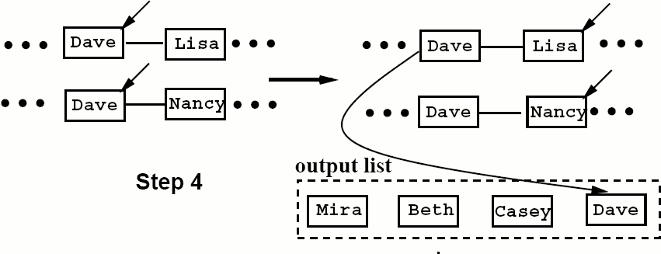
5.5.1 Two-finger Merge Algorithm

Slide 38
5.5.1 Two-finger Merge Algorithm
Often all the entries of one input list will have been transferred to the output list, leaving some entries in the other list
  Leftover entries will then be simply appended to the output without having to make any comparisons.

Slide 39
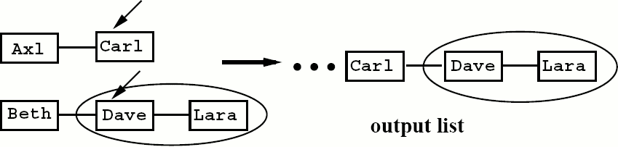
5.5.1 Two-finger Merge Algorithm

Slide 40
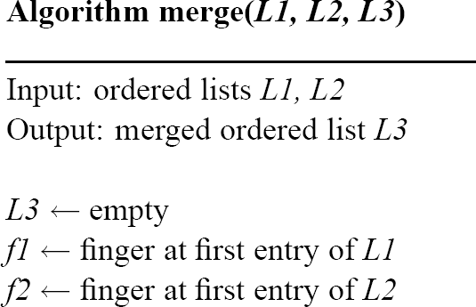
5.5.1 Two-finger Merge Algorithm

Slide 41
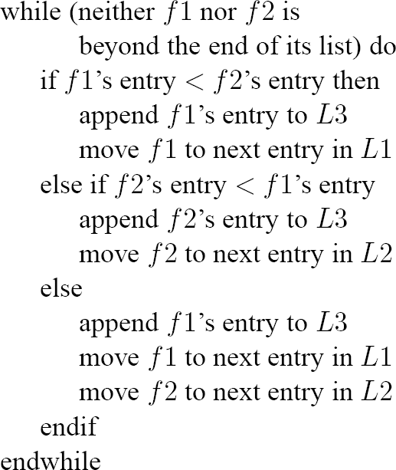
5.5.1 Two-finger Merge Algorithm

Slide 42
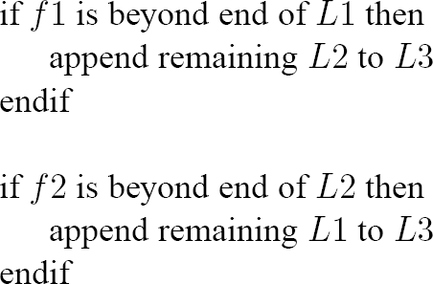
5.5.1 Two-finger Merge Algorithm

Slide 43
5.5.1 Two-finger Merge Algorithm
Let the first list contain m entries and the second list contain n entries.
  Best case (fewest comparisons needed).
    If all the entries of one list were less than all the entries of the other list.
  Assume that the m-list entries are all less than the n-list entries.
    Every entry of the m-list will be compared with the first entry of the n-list and appended to the output.
    Best case number of comparisons is min(m, n)

Slide 44
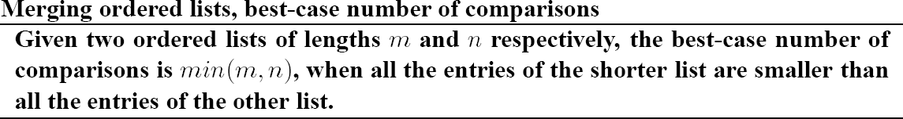
5.5.1 Two-finger Merge Algorithm

Slide 45
5.5.1 Two-finger Merge Algorithm
The worst case
  Every entry undergoes a comparison before it can be appended to the output list.
  The last entry will not be compared.
  M + n – 1

Slide 46
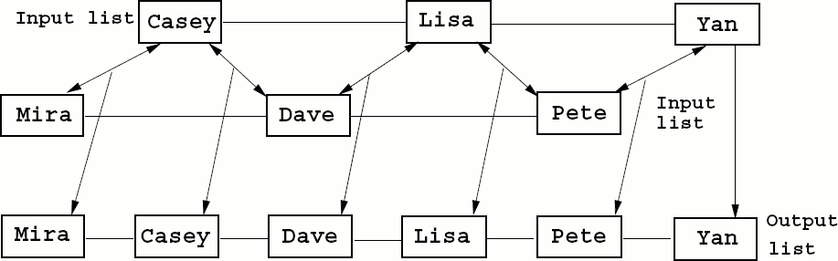
5.5.1 Two-finger Merge Algorithm

Slide 47
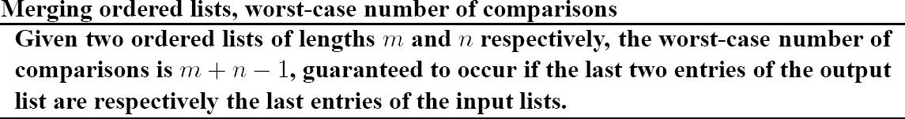
5.5.1 Two-finger Merge Algorithm

Slide 48
5.6 List Consolidation Using OrderedList
This merge algorithm is computing the union of two ordered lists.
  In the example of the party lists, deleting from the merged insert list, the entires of the merged delete list is the same as computing the difference.
  Often, we want to compute the intersection of two ordered lists.

Slide 49
5.6.1 Merger: A Utility Class
Define a class called Merger that would provide three methods:
  Union,
  Difference,
  Intersection
    Provides a set of utility methods for OrderedList objects.

Slide 50
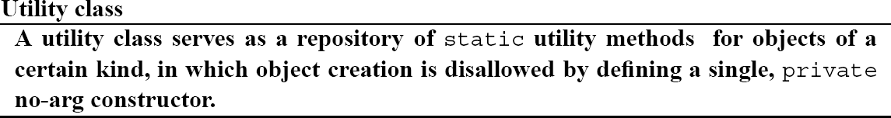
5.6.1 Merger: A Utility Class

Slide 51
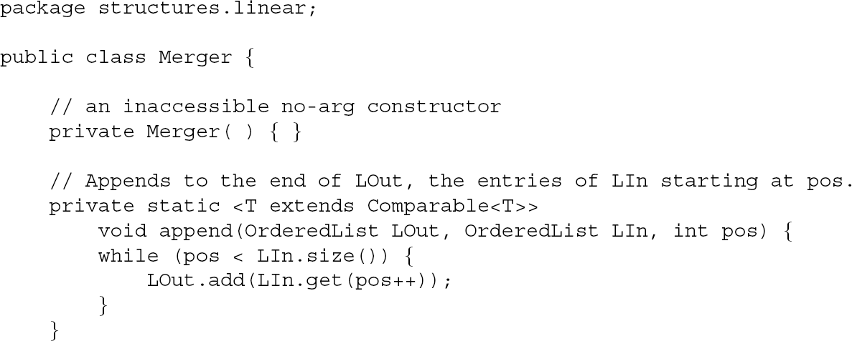
5.6.1 Merger: A Utility Class

Slide 52
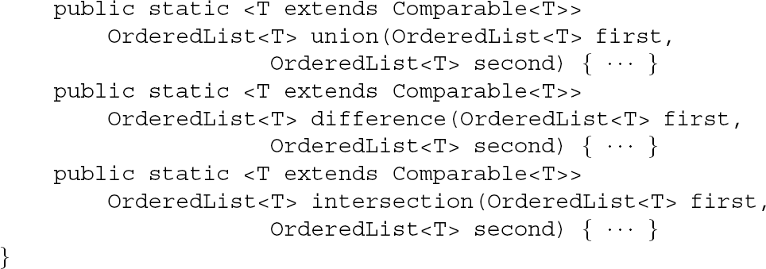
5.6.1 Merger: A Utility Class

Slide 53
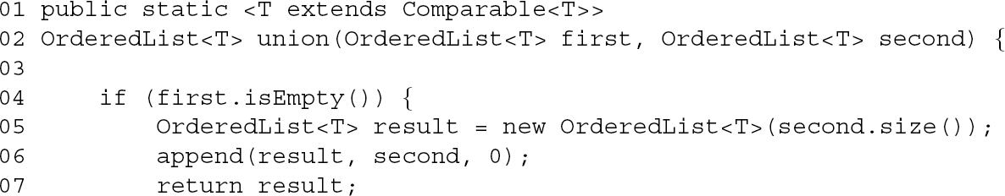
5.6.1 Merger: A Utility Class

Slide 54
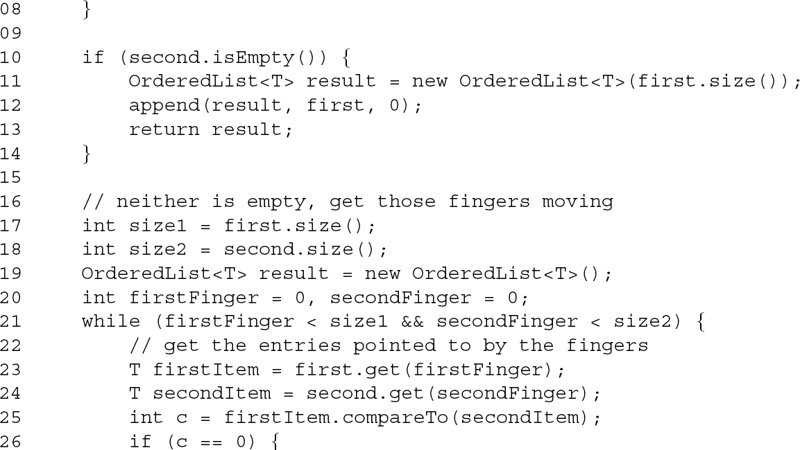
5.6.1 Merger: A Utility Class

Slide 55
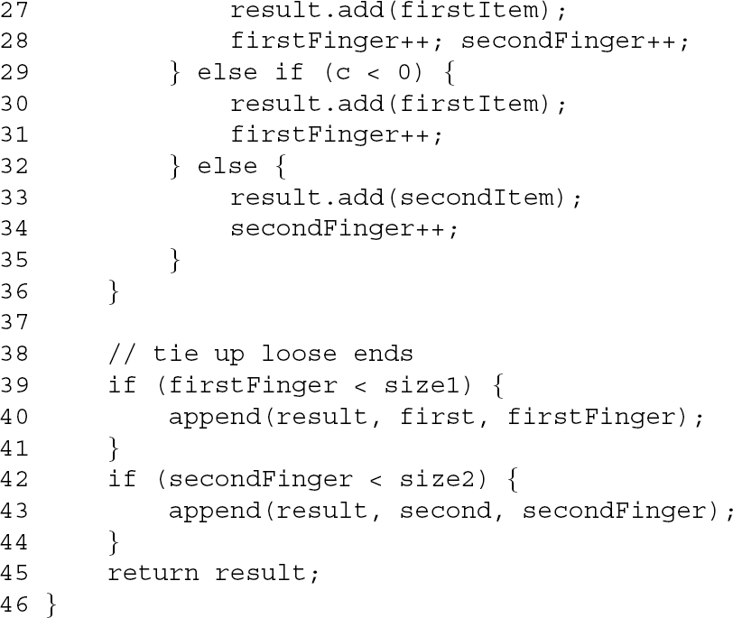
5.6.1 Merger: A Utility Class

Slide 56
5.6.1 Merger: A Utility Class
List L1 and L2 of the algorithm are the parameters first and second.
  L3 is the new OrderedList<T> instance returned by the method.

Slide 57
5.6.2 A Consolidation Class
The lists we want to process contain the names of people that we would store as String objects, so we will instantiate the generic OrderedList<T> class with String for T.

Slide 58
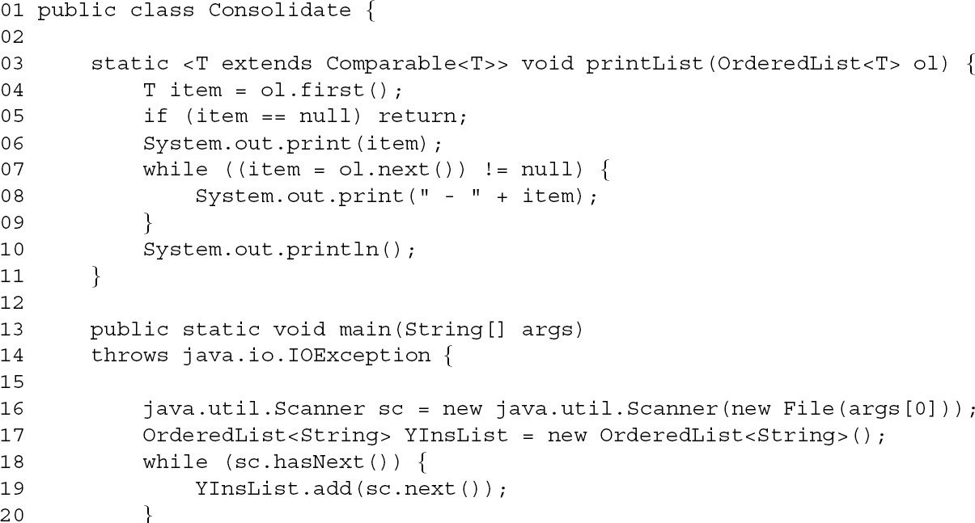
5.6.2 A Consolidation Class

Slide 59
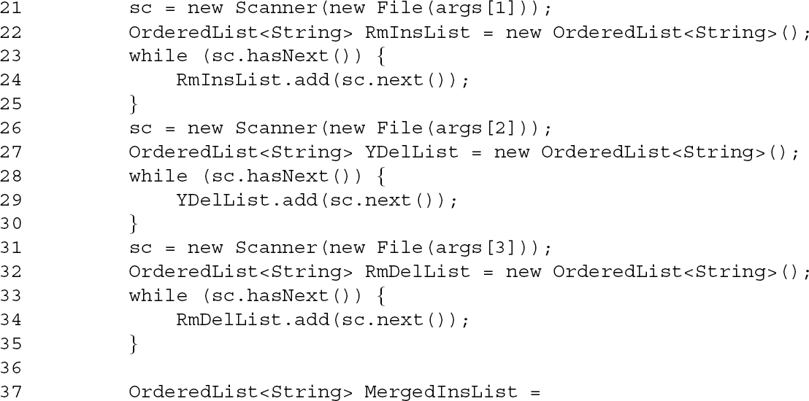
5.6.2 A Consolidation Class

Slide 60
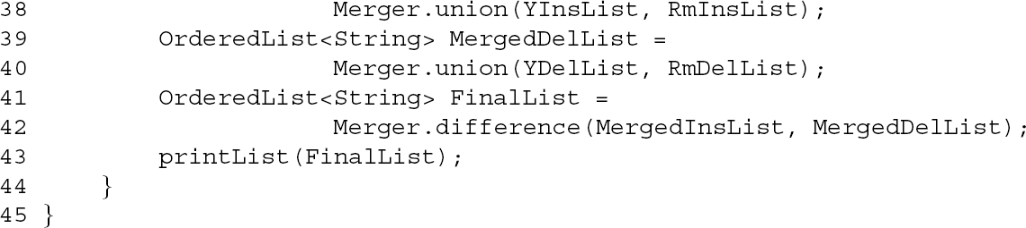
5.6.2 A Consolidation Class

Slide 61
5.6.2 A Consolidation Class
YinsLis (your insert list)
YdelList (your delete list)
RmInsList (your roommate's insert list)
RmDelList (your roommate's delete list)

Slide 62
5.7 OrderedList Class Implementation
java.util ArrayList can grow automatically to accommodate new entries.

Slide 63
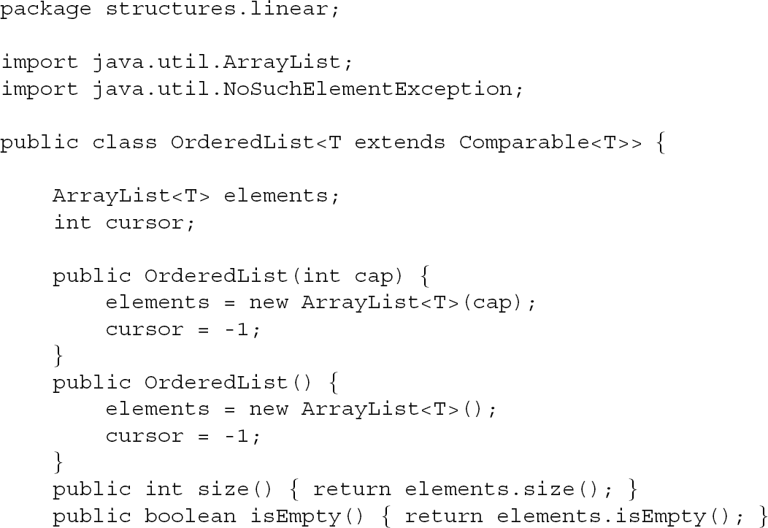
5.7 OrderedList Class Implementation

Slide 64
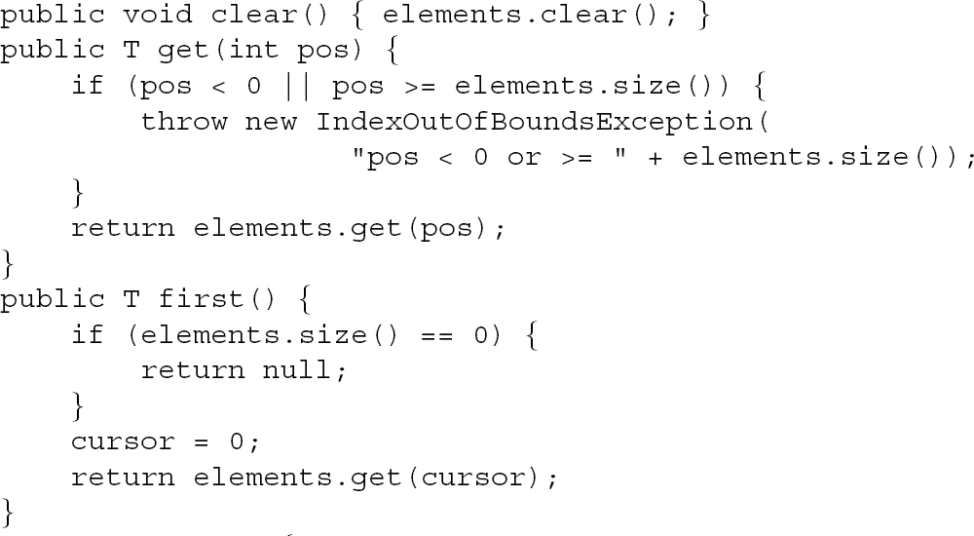
5.7 OrderedList Class Implementation

Slide 65
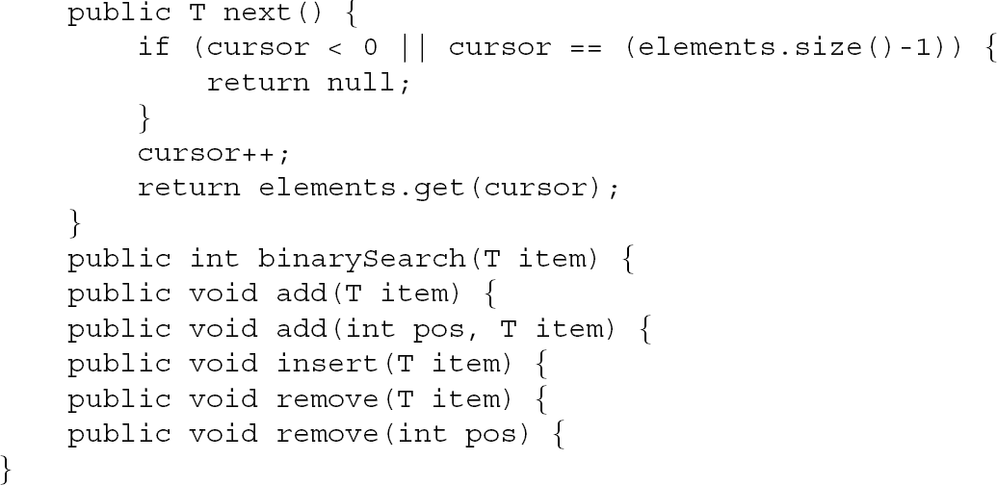
5.7 OrderedList Class Implementation

Slide 66
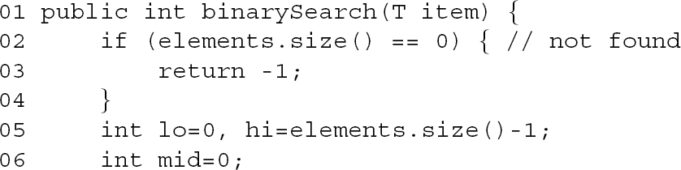
5.7 OrderedList Class Implementation

Slide 67
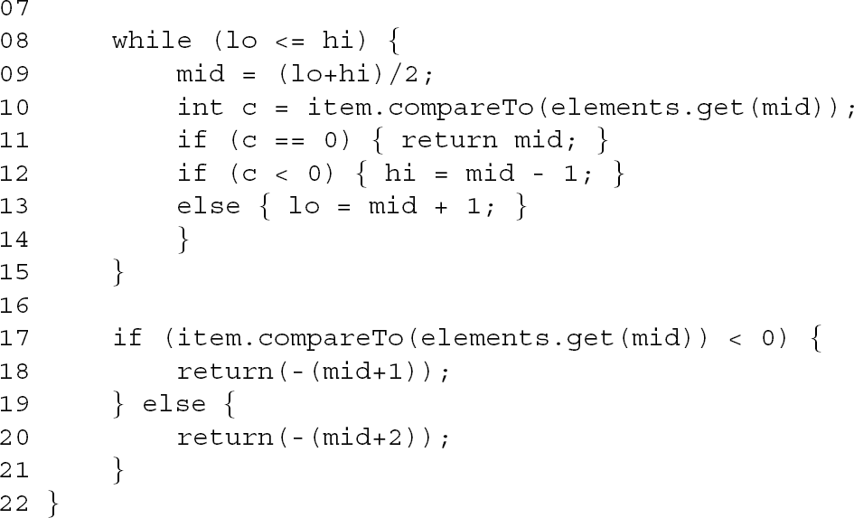
5.7 OrderedList Class Implementation

Slide 68
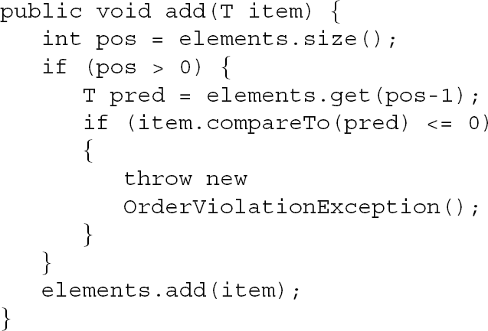
5.7 OrderedList Class Implementation

Slide 69
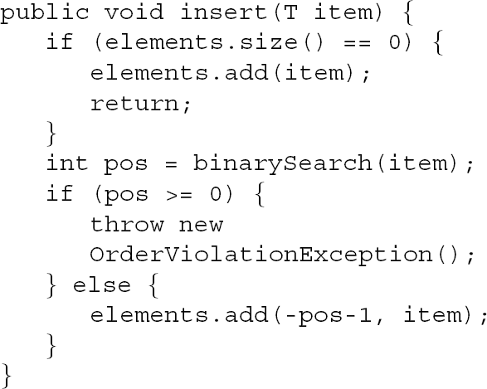
5.7 OrderedList Class Implementation

Slide 70
5.7 OrderedList Class Implementation
add(int, T) is different from the above insertion methods in that an index for insertion is given as an argument.

Slide 71
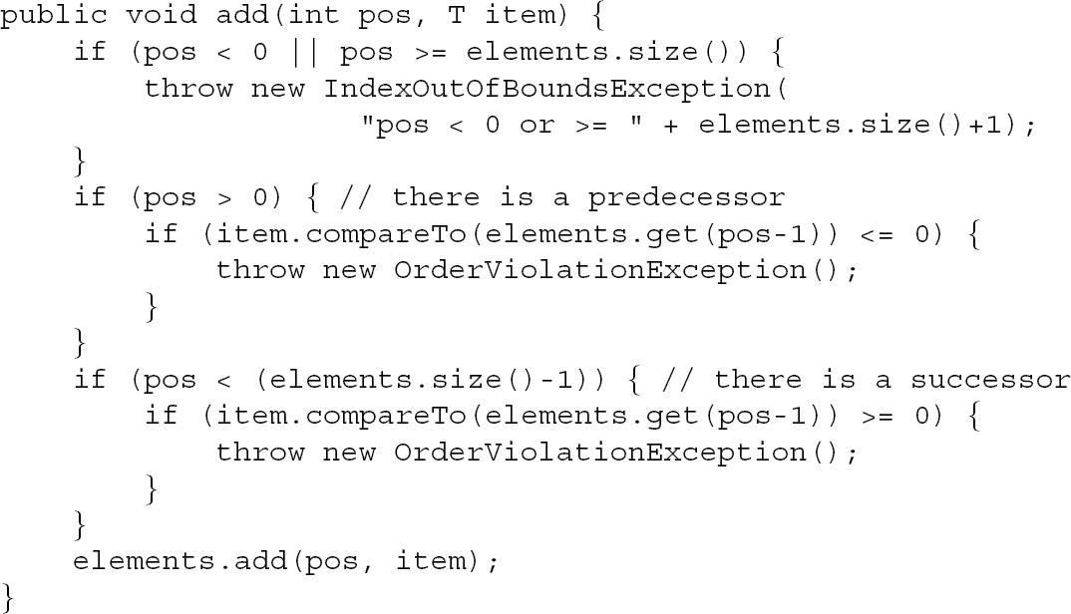
5.7 OrderedList Class Implementation

Slide 72

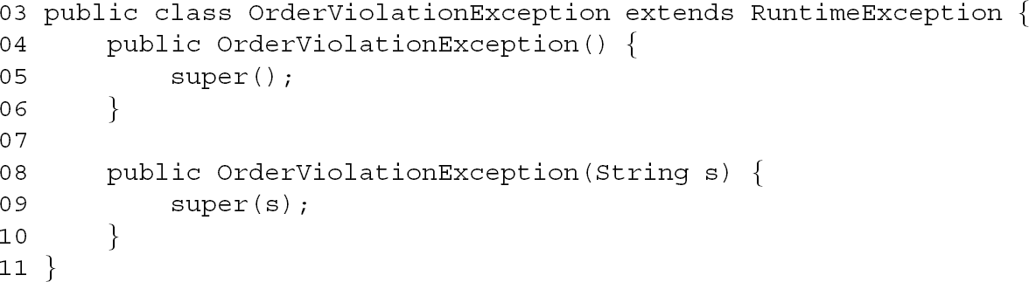
5.7 OrderedList Class Implementation

Slide 73
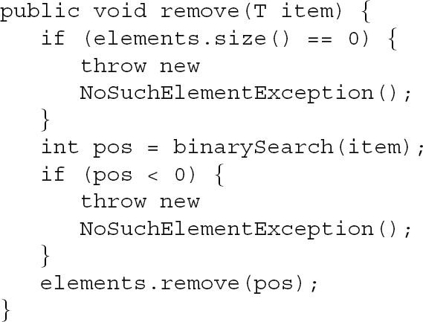
5.7 OrderedList Class Implementation

Slide 74
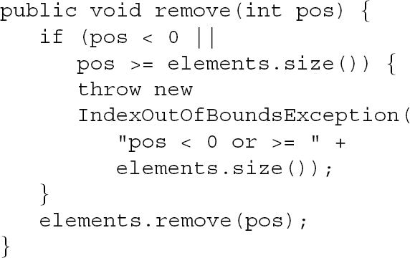
5.7 OrderedList Class Implementation

Slide 75
5.8 Summary
An ordered list is a linear collection of entries arranged in sorted order of keys.
The primary advantage of ordered list is that it is significantly faster to search using binary search.
The primary disadvantage of an ordered list adding an entry takes up to O(n) time.
Worst-case binary search of an array with n entries is 2[log(n + 1)] – 1 for success, and 2[log(n + 1)] for failure, O(log n).

Slide 76
5.8 Summary
The best-case number of comparisons to merge these lists is min(m, n).
The worst-case number of comparisons to merge these lists is m + n – 1.
All objects that are admitted to an ordered list implement methods that compare pairs of objects for equality, less than and greater than.
A utility class is one that serves as a repository of static utility methods that operate on objects of a certain type.

Slide 77
5.8 Summary
The ordered list is implemented using a vector to ensure fast, O(log n), binary search.

